Slide 1







Kuma Service Mesh
Architecture, Installation and Key Features

Slide 2

Agenda
Introduction to Service Mesh
Kuma Overview
Demo
Questions

Slide 3
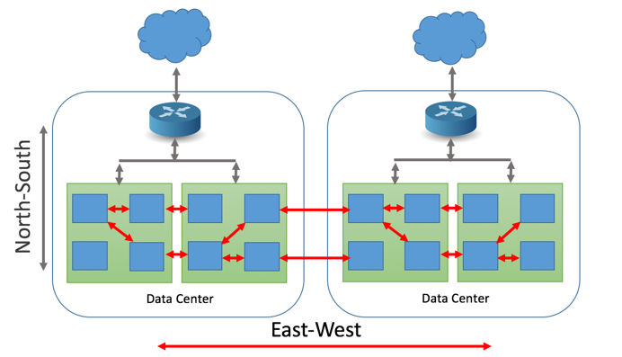
Network Traffic Flow

Slide 4
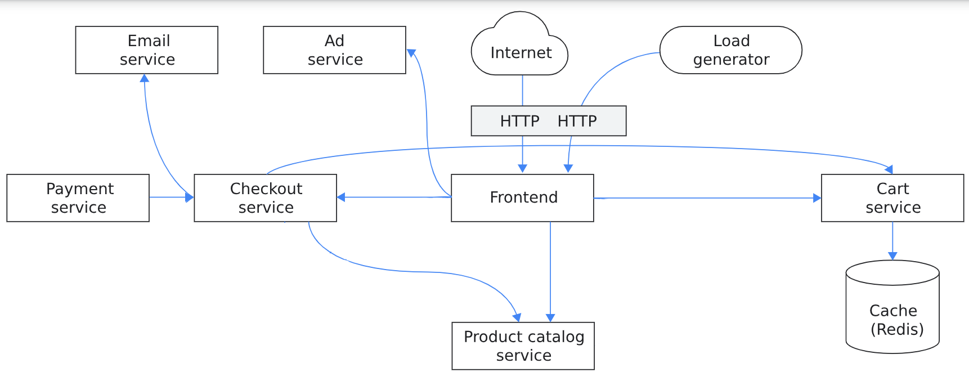
Microservices Architecture Complexities

Slide 5
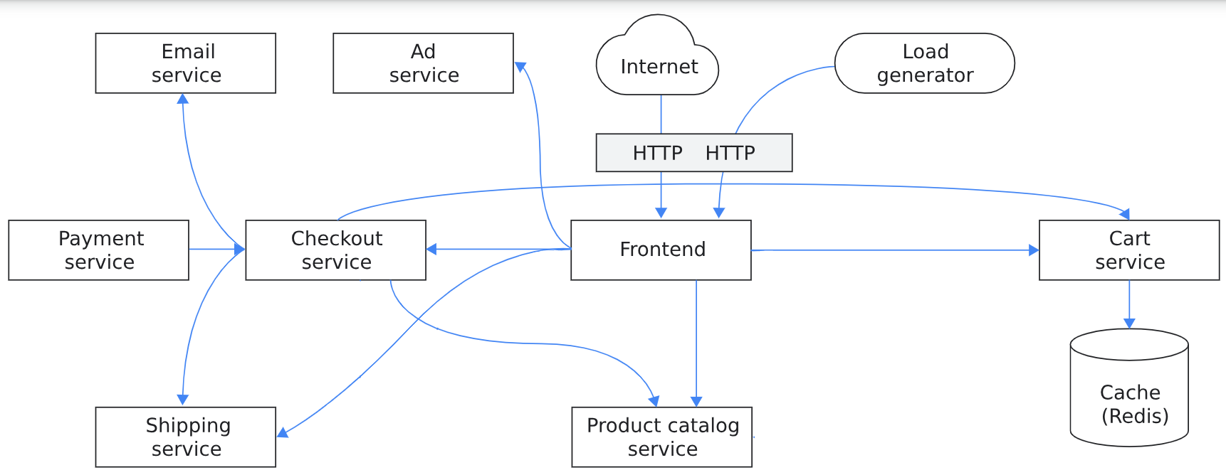
Microservices Architecture Complexities

Slide 6
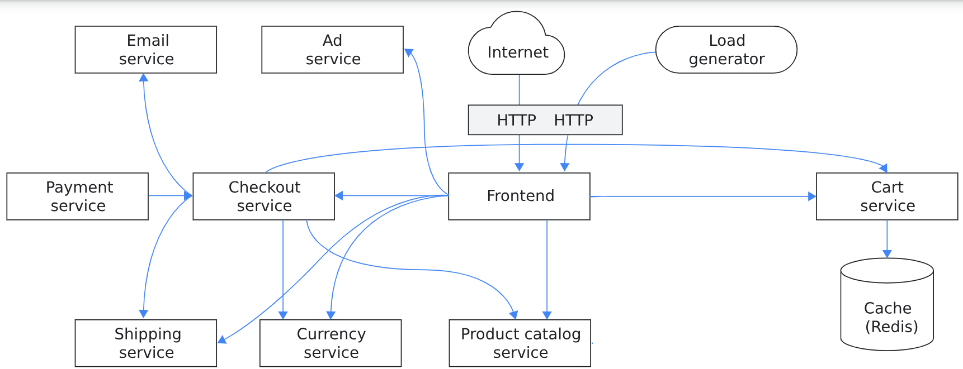
Microservices Architecture Complexities

Slide 7
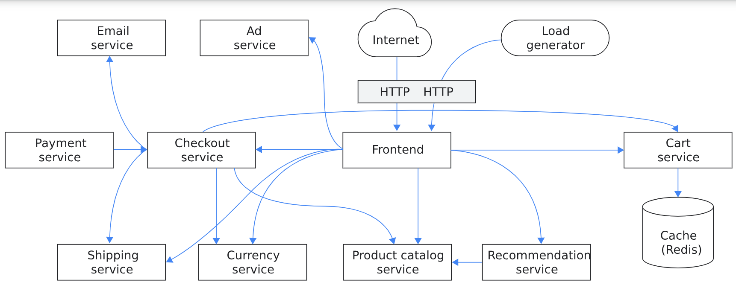
Microservices Architecture Complexities

Slide 8
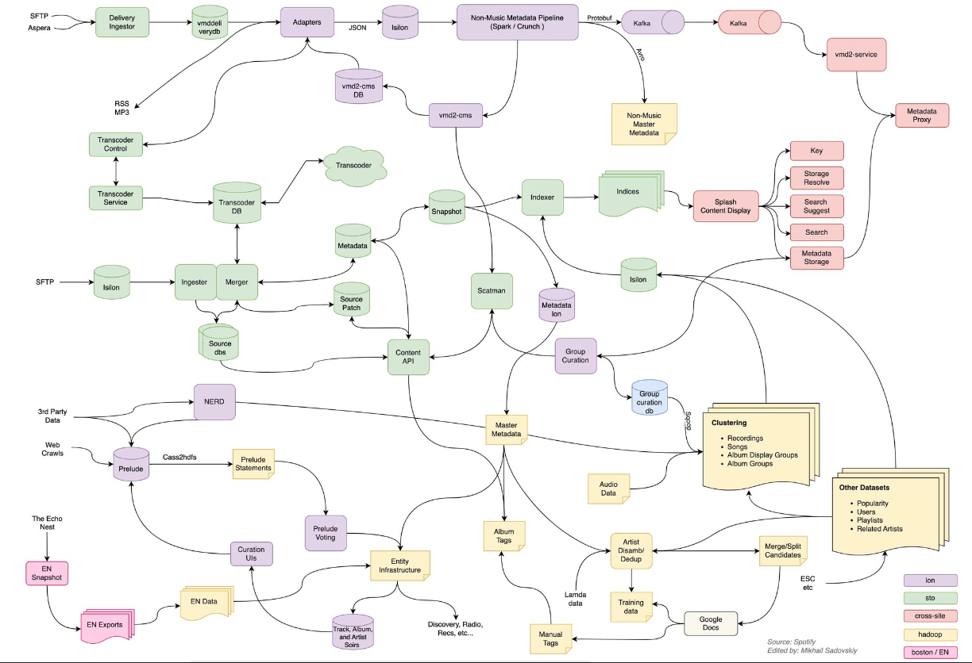

Slide 9

Service Mesh Features
Service Discovery
Load Balancing
Traffic Management
Security
Observability
Policy Enforcement
Dynamic Configuration

Slide 10
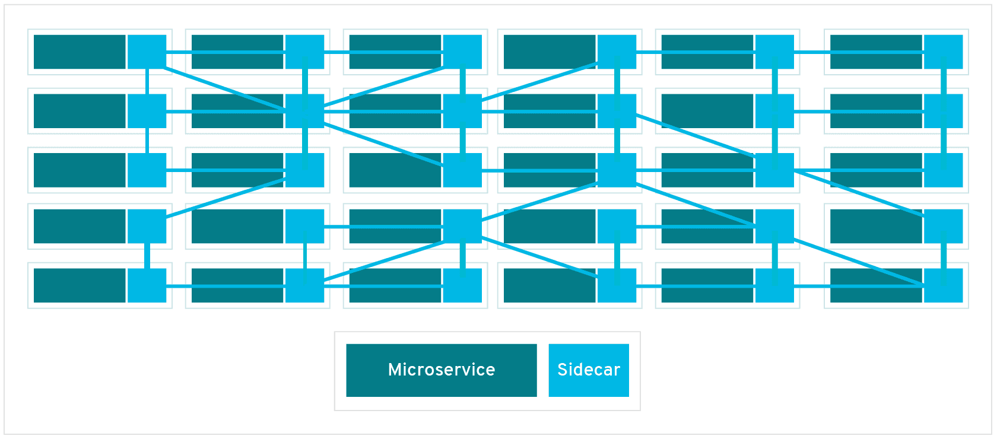
How does it work?
Sidecar
Proxy

Slide 11

How does it work?

Slide 12
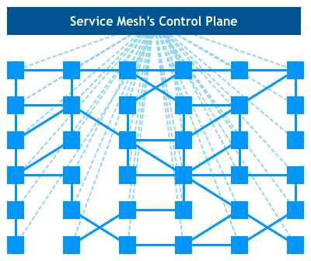
How does it work?
Service Mesh Control Plane
Centralized Management
Manages and Configures proxies

Slide 13
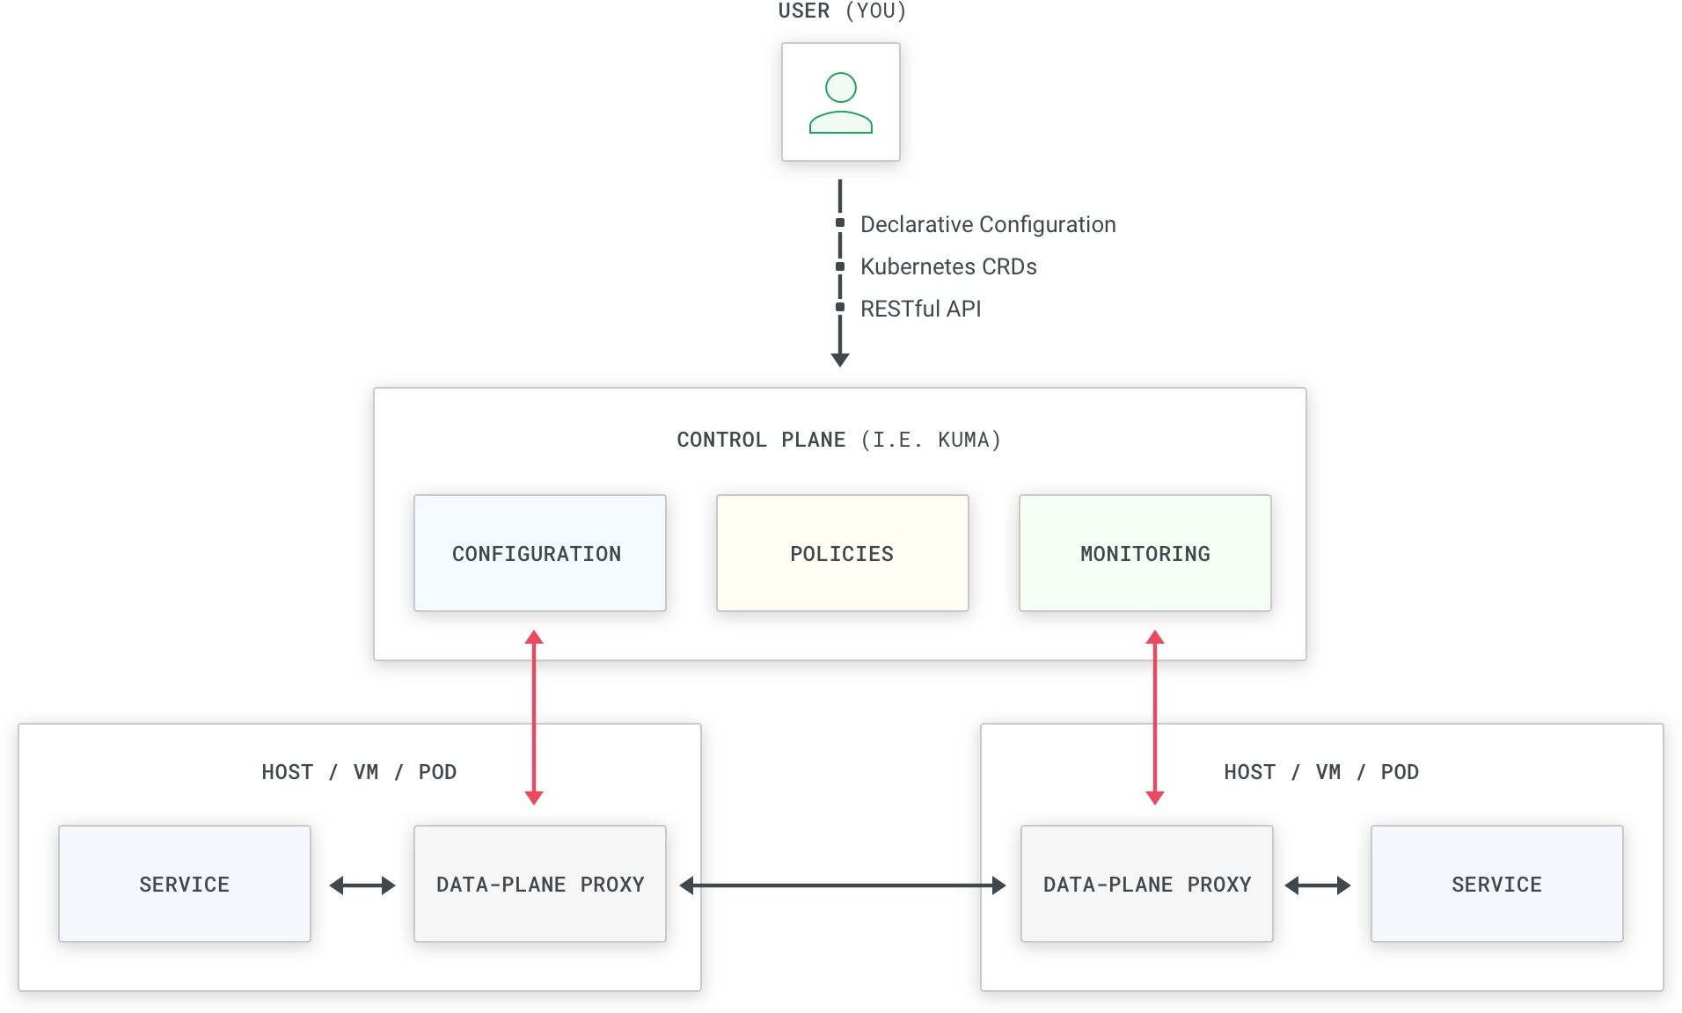
Kuma
Control Plane
Kuma binary
Date Plane
Envoy binary

Slide 14
Kuma
Why Kuma?
Universal and Kubernetes-Native
Deployment:
Standalone and Multi-Zone
Multi-Mesh
Envoy-Based
Easy to use
Enterprise-Ready

Slide 15
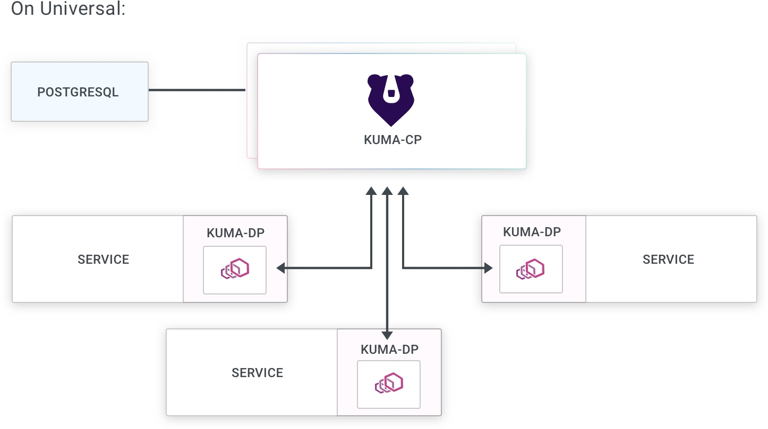
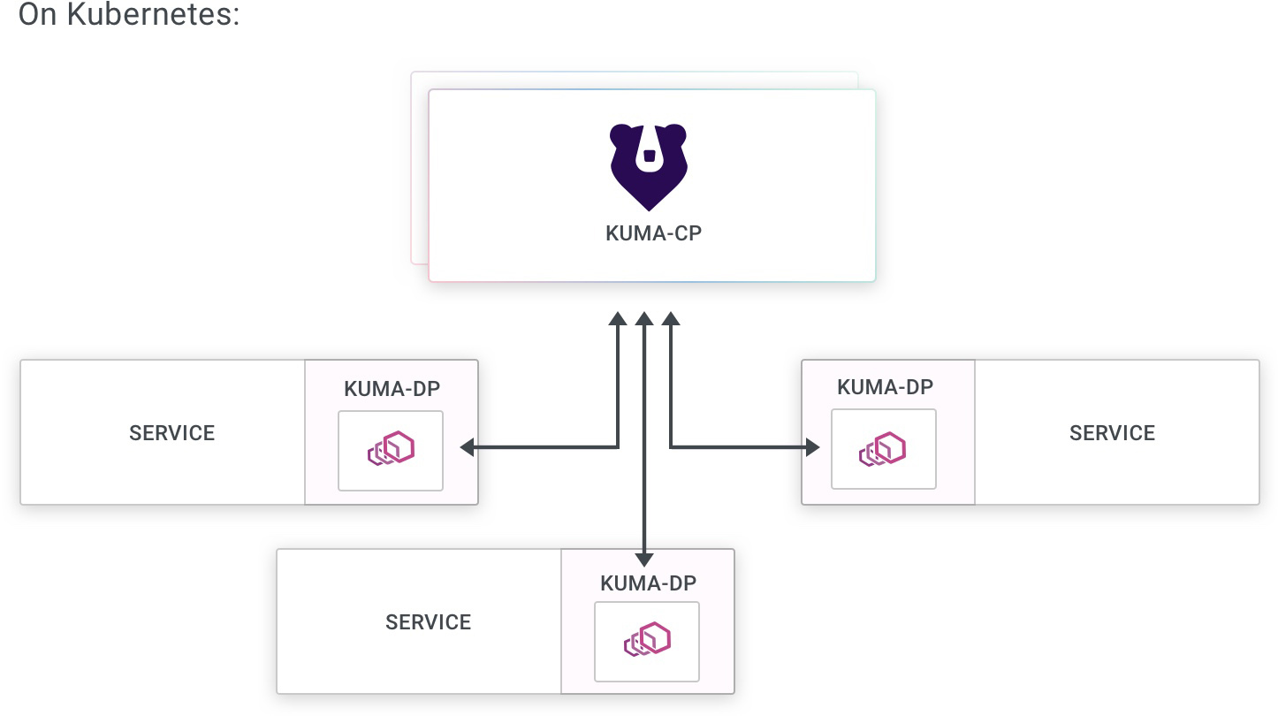
Kuma
Universal
Kubernetes

Slide 16
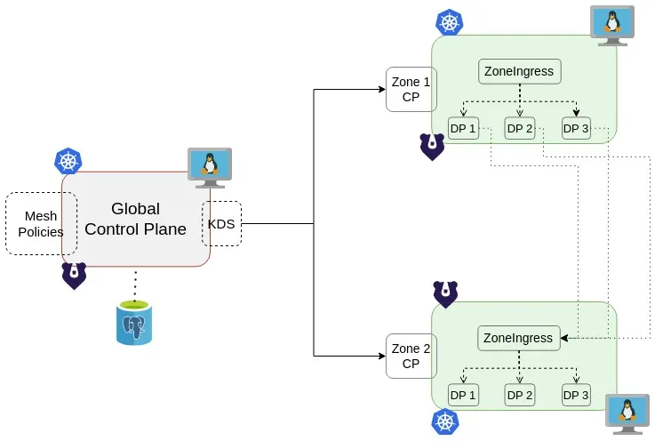
Deployment Topologies

Slide 17
Kuma Policies
SECURITY
mTLS
TRAFFIC CONTROL
OBSERVABILITY
Service Mesh
Multi mesh
Traffic Permissions
Traffic Metrics
Traffic Trace
Traffic Log
Health Check
Circuit Breaker
Fault Injection
Timeouts
Rate limit
Traffic Routing
….

Slide 18
Demo
What we will cover
Kuma Service Mesh
Deploy a demo application on K8s
Enable mesh on it
Explore Observability
Explore policies
References
https://docs.konghq.com/ Random images from google, true source unidentified

